Slide 2
PRE-DISASTER: PERSONAL PREPAREDNESS & SECURING YOUR HOME TRAINING
SEISMIC SAFETY OUTREACH PROGRAM
Some Resource Pictures from Google.com

Slide 3
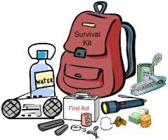
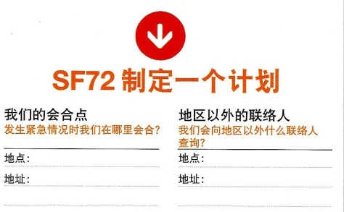
SF DEPARTMENT OF EMERGENCY
The There Actions for Disaster Preparedness:
Get Connected
Gather Supplies
Make A Plan

Slide 4
WHAT CAN HAPPEN HERE?
SEISMIC SAFETY OUTREACH PROGRAM

Slide 5
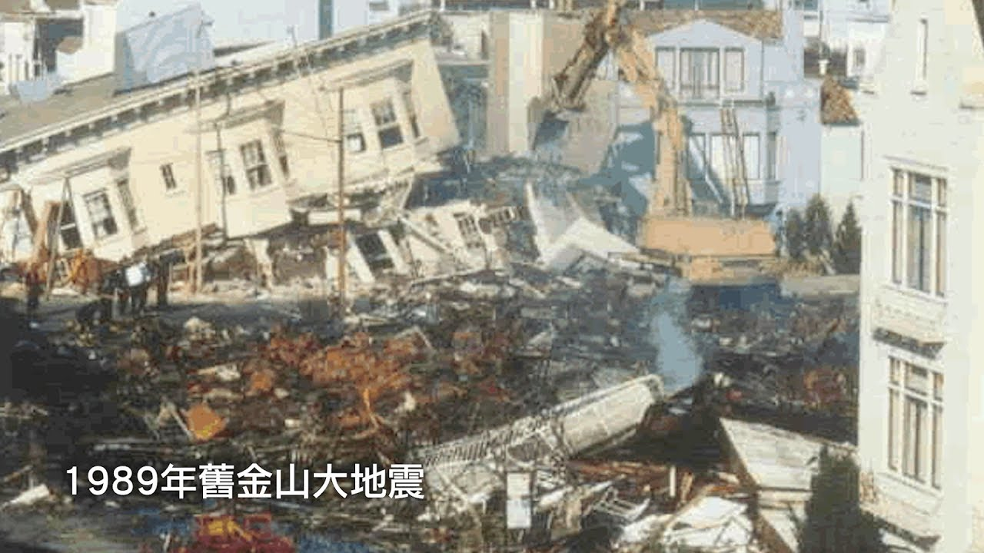
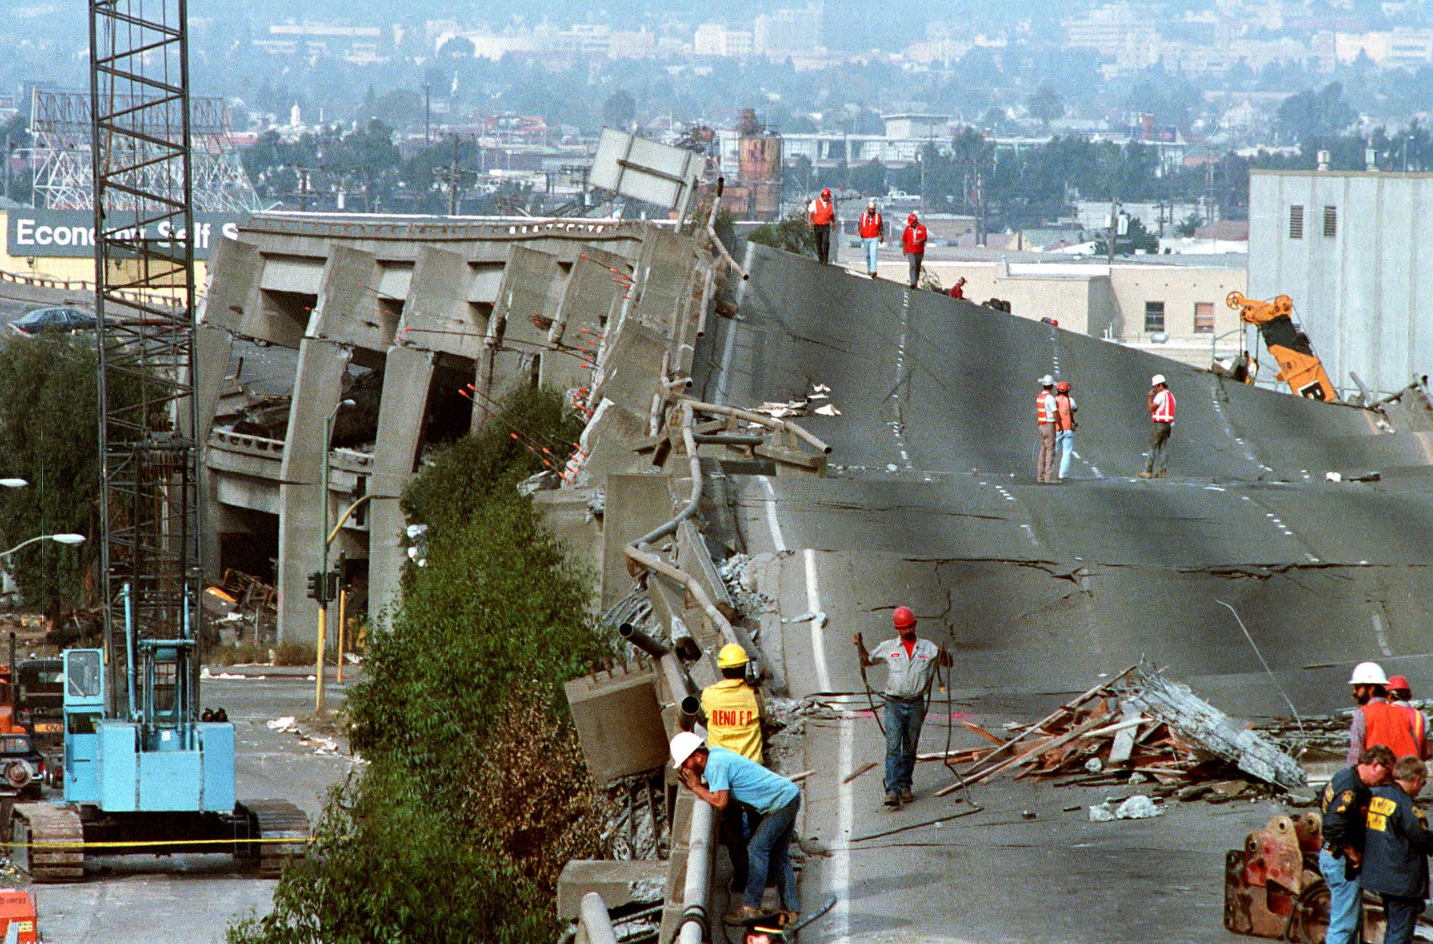
earthquake

Slide 6
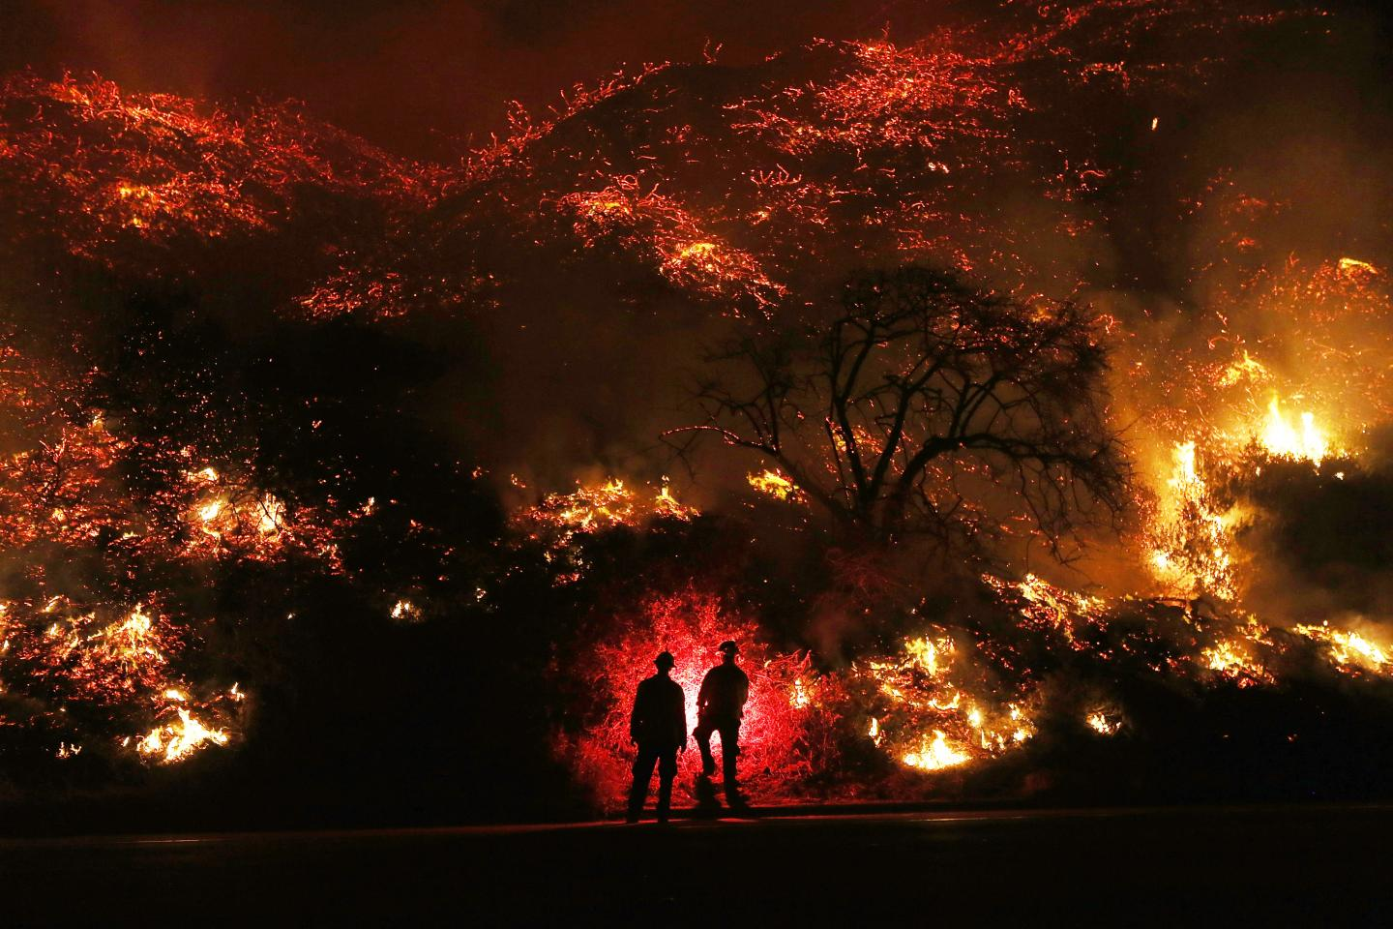
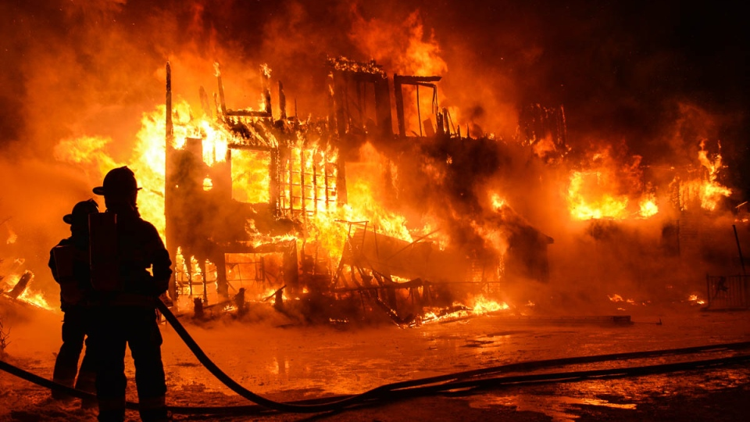
Fires – Wildfires, House fires

Slide 7
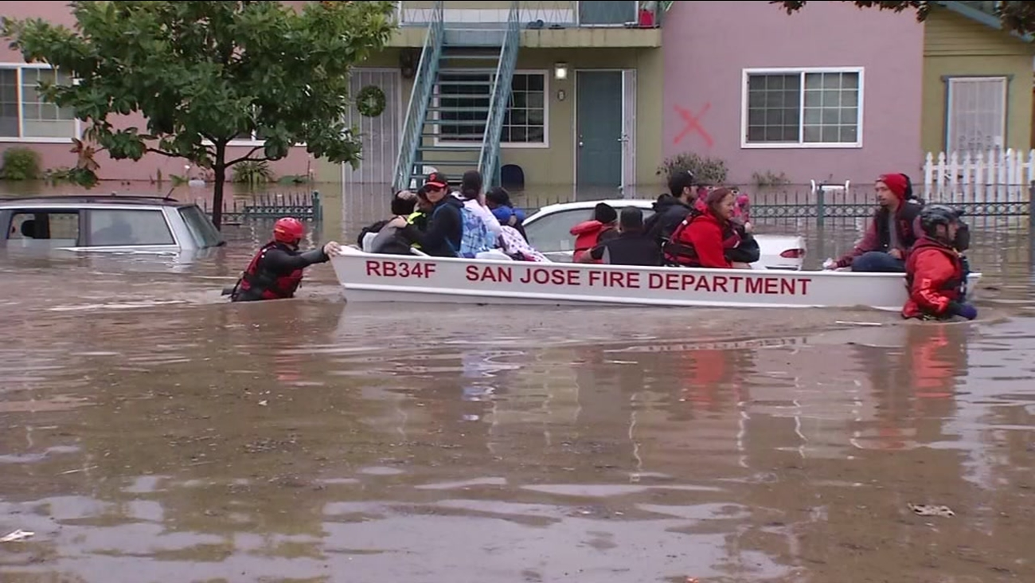
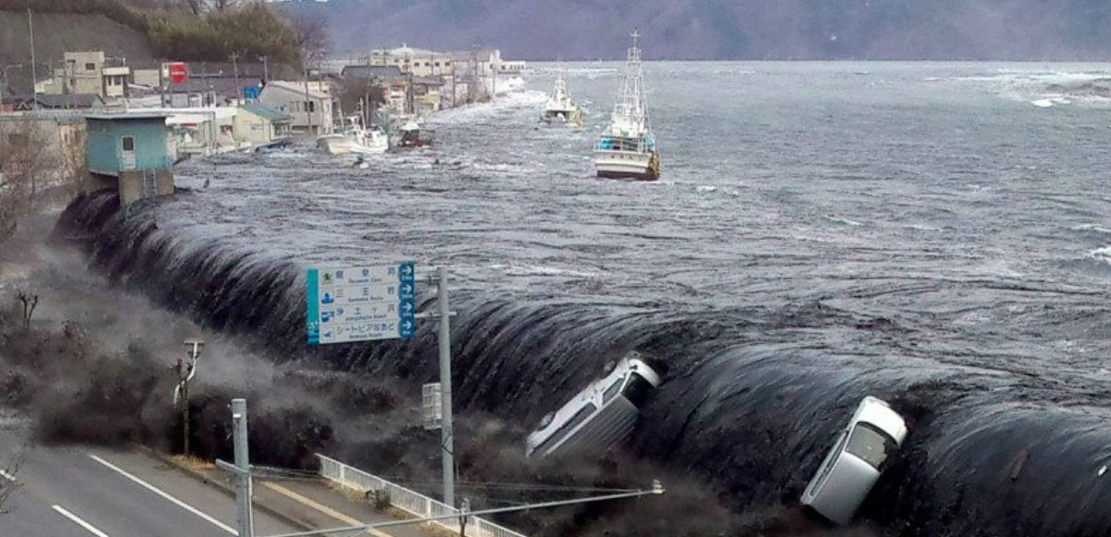
Flooding
Tsunami

Slide 8
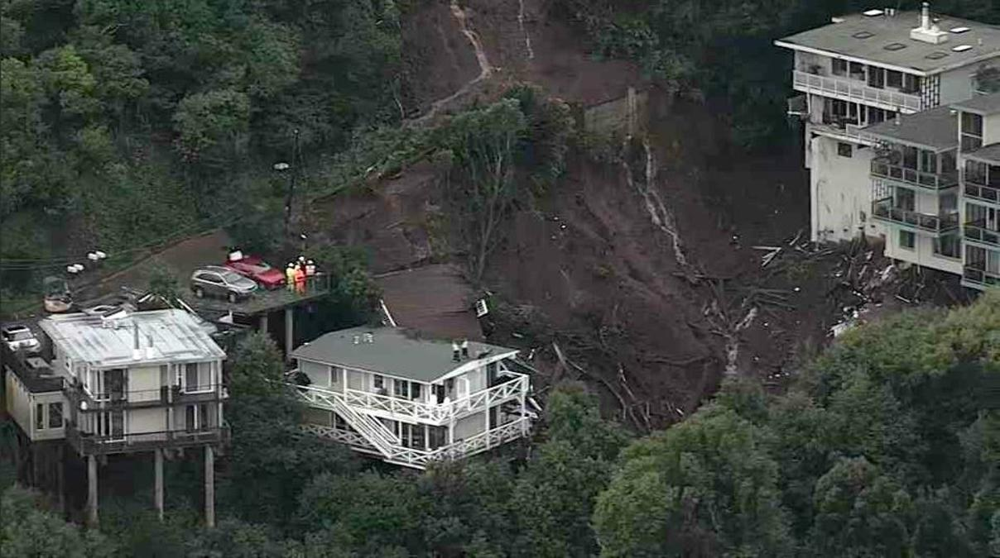
Landslides

Slide 9
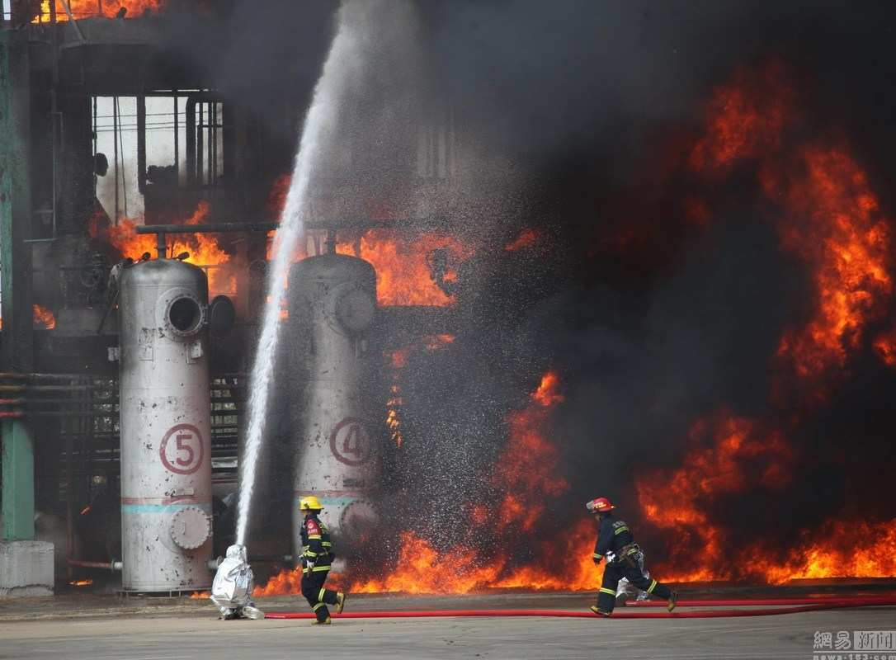
Hazardous Materials

Slide 10
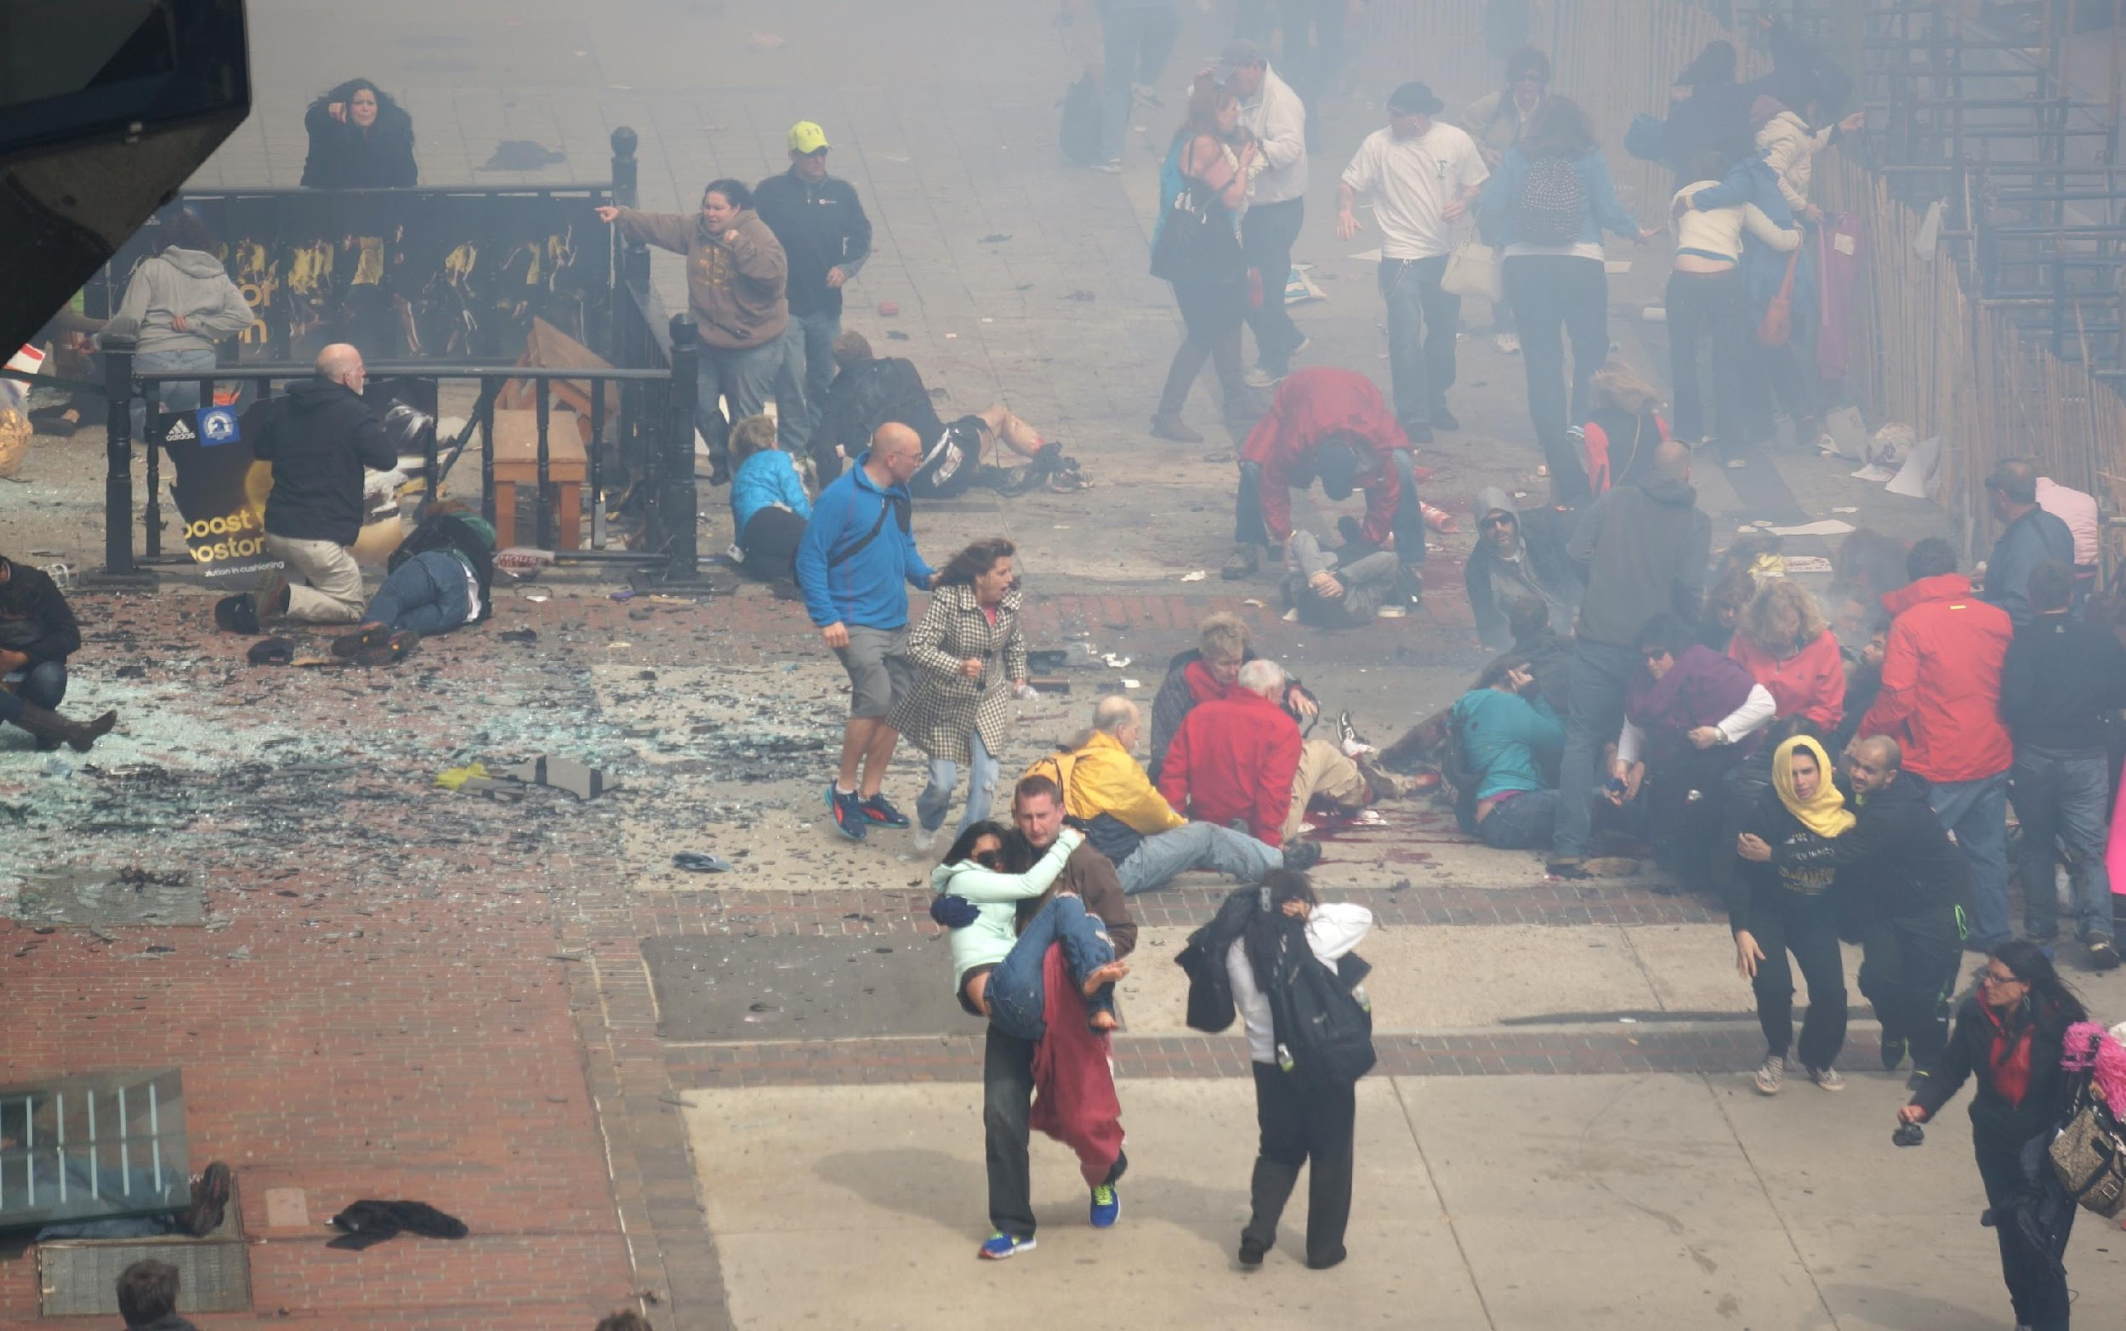
Terrorist acts

Slide 11
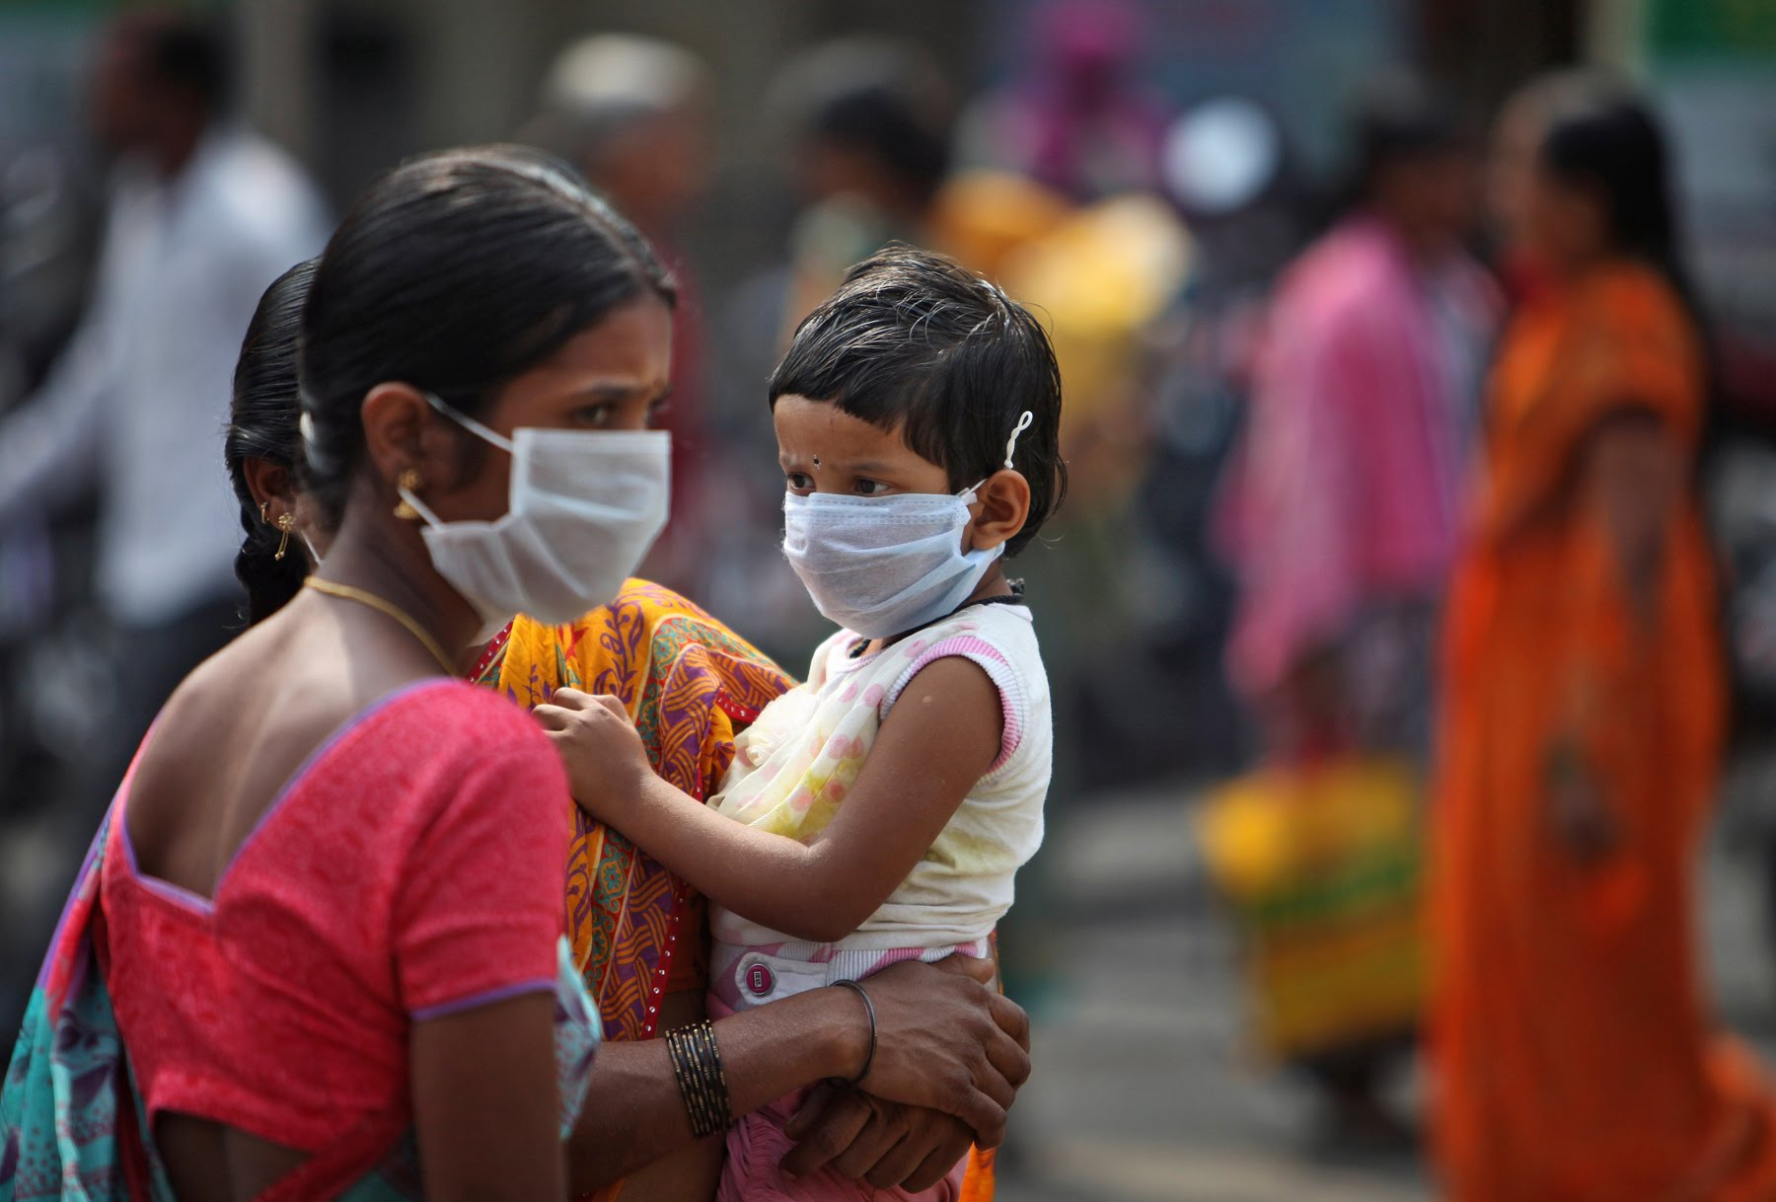
Avian Flu
Pandemic Flu

Slide 12
Practically Speaking -
No Power
No Heat
No Water
Emergency Help Unavailable
Family Separation
Injuries
Home Damaged & Unable to return
SEISMIC SAFETY OUTREACH PROGRAM

Slide 13
ARE YOU READY?
FOR THE NEXT BIG ONE ?
SEISMIC SAFETY OUTREACH PROGRAM

Slide 14
STEP 1: GET CONNECTED
SEISMIC SAFETY OUTREACH PROGRAM

Slide 15
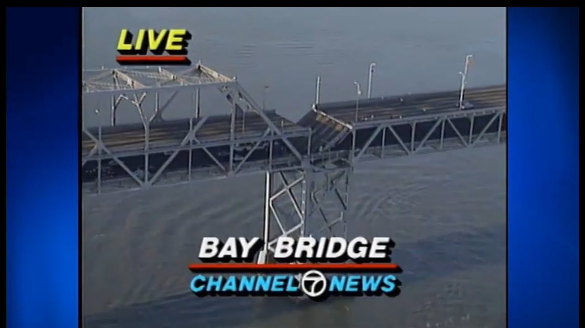
Television

Slide 16
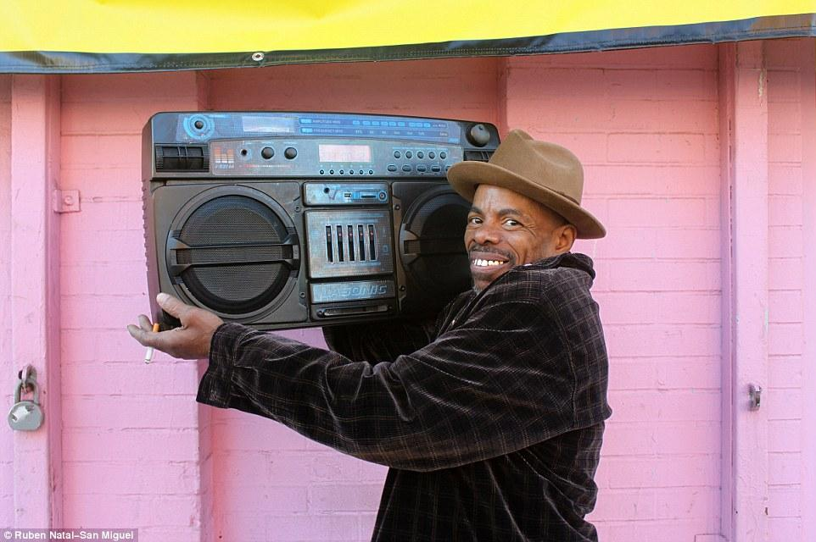
RADIO &
NOAA Weather Station
KCBS 106.9FM
740 AM

Slide 17
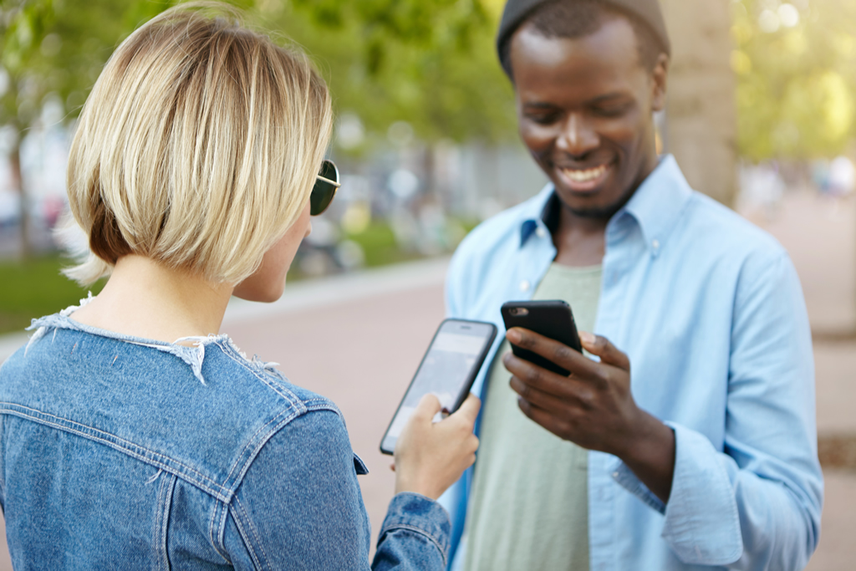
PRINTED NOTICES & INTERNET
Person to person
Phone or Text Message
SEISMIC SAFETY OUTREACH PROGRAM

Slide 18
ALERTSF
a text-based notification system for San Francisco's residents and visitors.
text AlertSF to 888-777
SEISMIC SAFETY OUTREACH PROGRAM

Slide 19
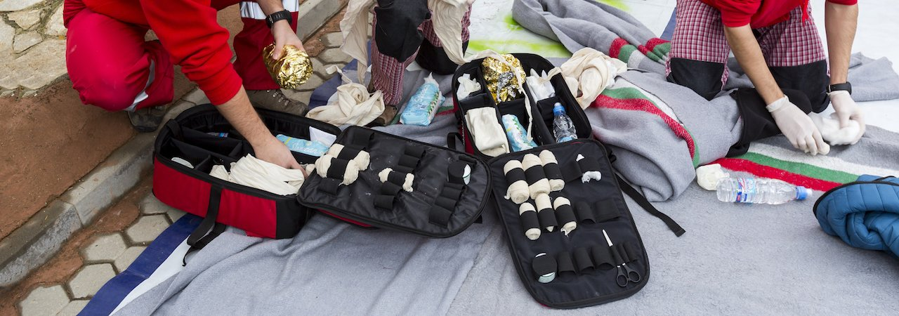
STEP 2 – GATHER SUPPLIES
Prepare to meet your Own Need
For up to 5-7 DAYS
What do you think you will need?
SEISMIC SAFETY OUTREACH PROGRAM

Slide 20
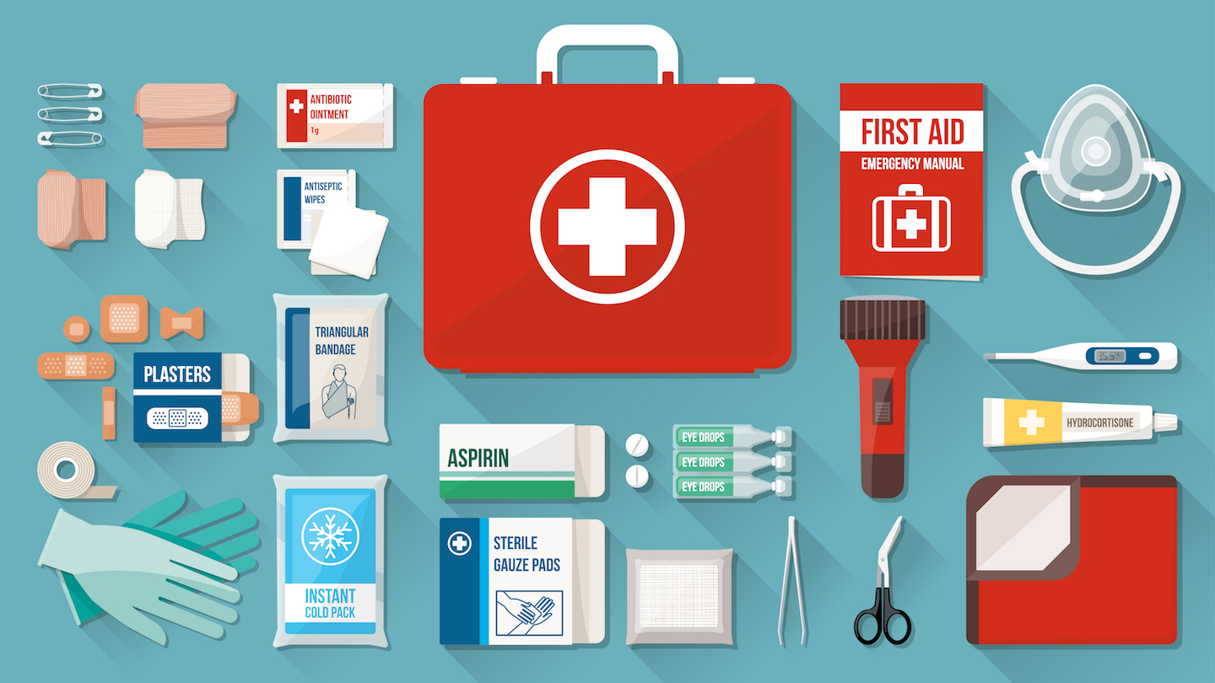
ESSENTIALS
Water – 1 Gal/person/day
First Aid Kit
Flashlight + extra batteries
SEISMIC SAFETY OUTREACH PROGRAM

Slide 21
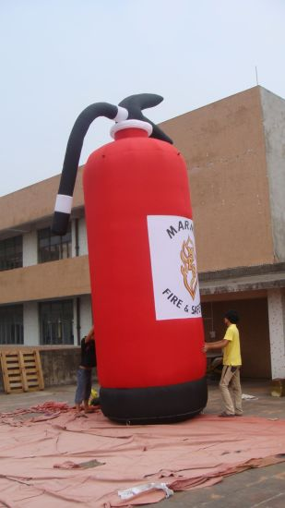
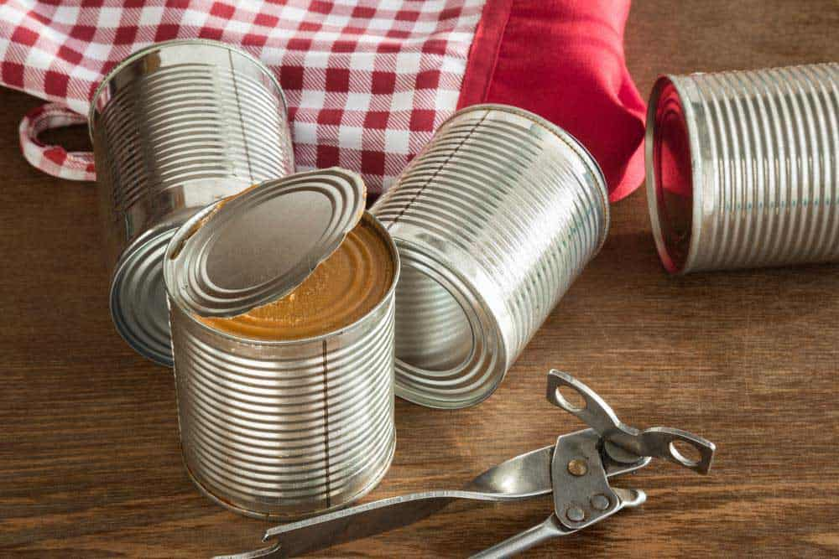
Fire Extinguisher
Can-opener
Food – Non-perishable,
No cooking, No water,
Nutritious, Tasty.

Slide 22
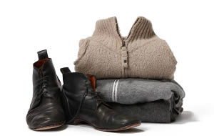
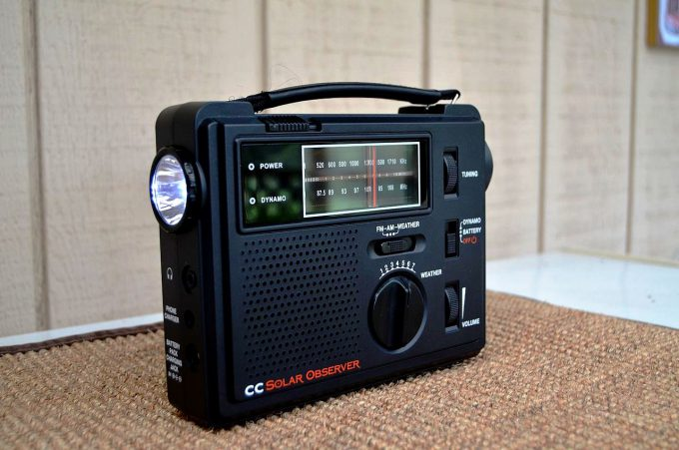
Useful
Warm clothes,
Sturdy shoes, gloves
Radio
Cash

Slide 23
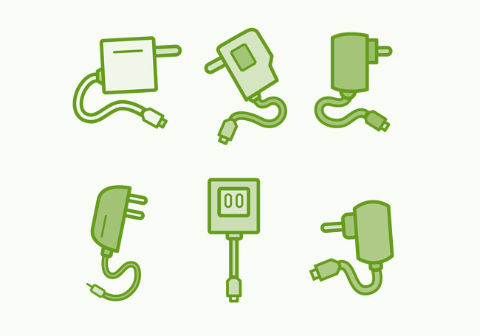
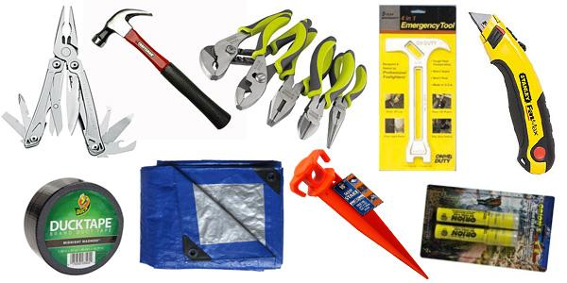
Sleeping bag or
blanket
Cell phone Charger
Power bank
Tools

Slide 24
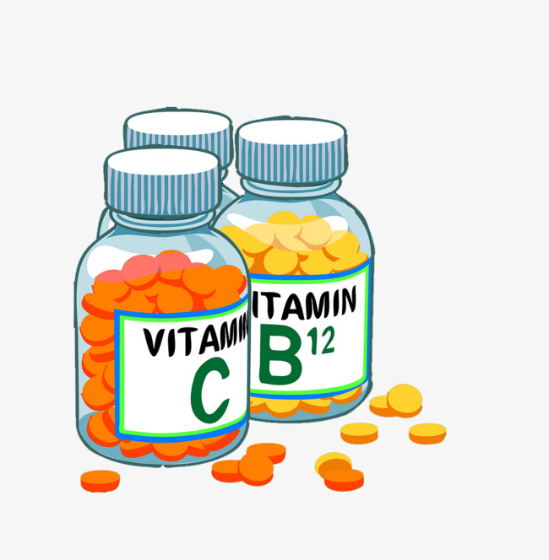
PERSONAL
Medications -
prescription &
non-prescription
Sweet Treats
Hygiene + Sanitation

Slide 25
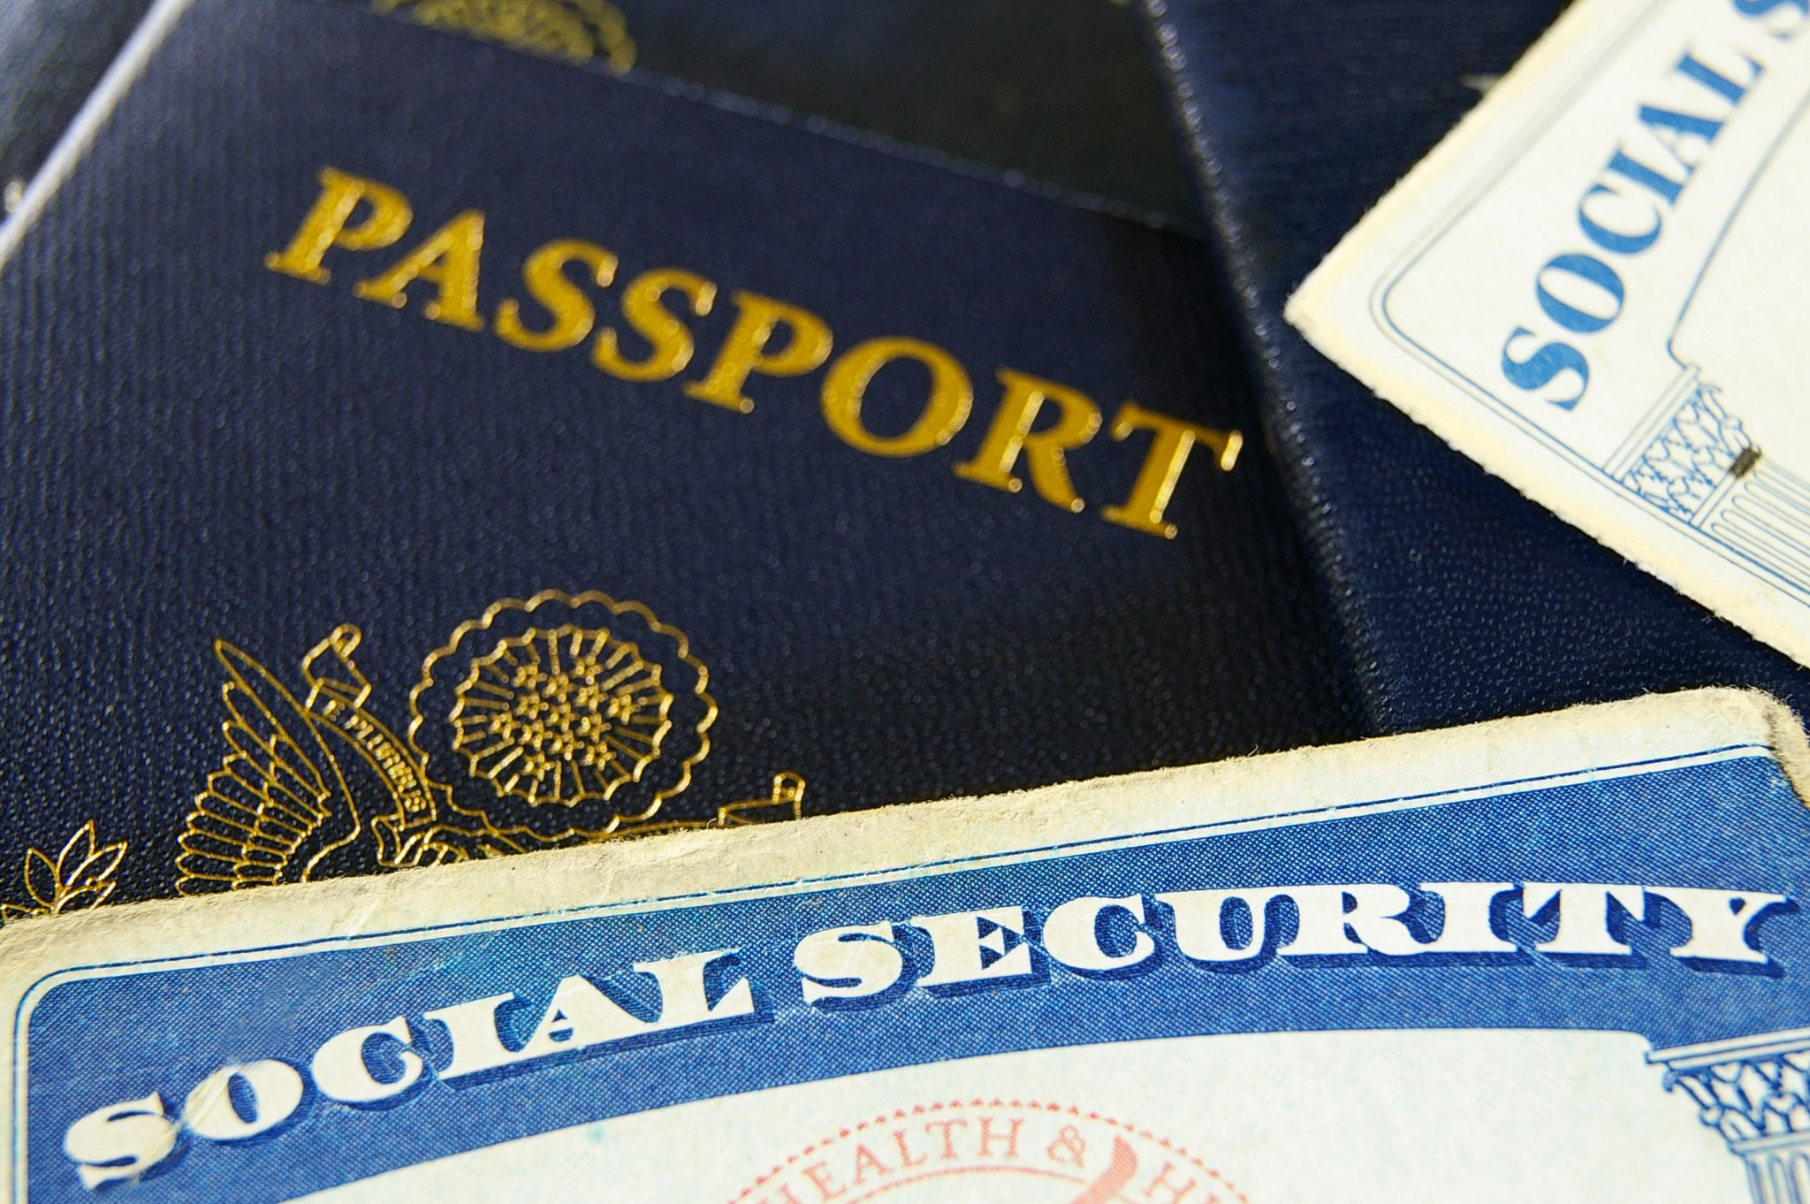
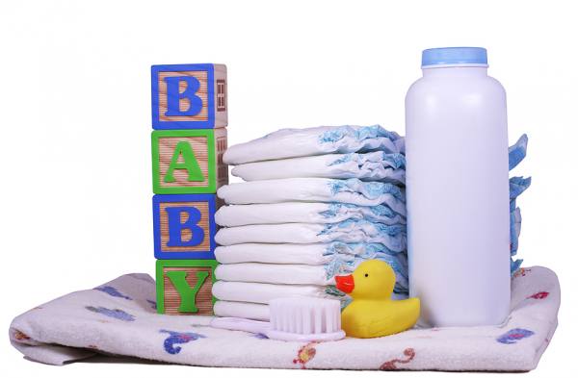
Personal Documents
Children Toys and Games
Pet Items

Slide 26
Electric/Solar Powered Generator
Rechargeable or Hand-Crank Flashlight

Slide 27
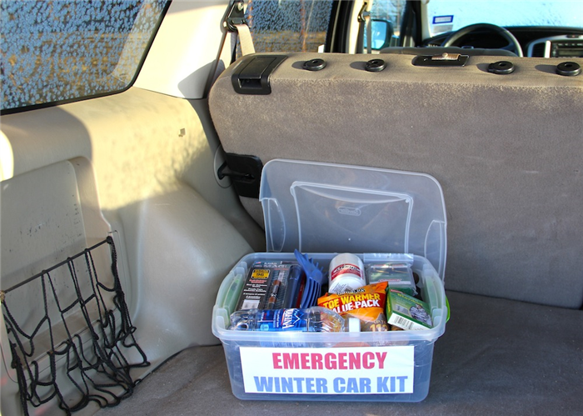
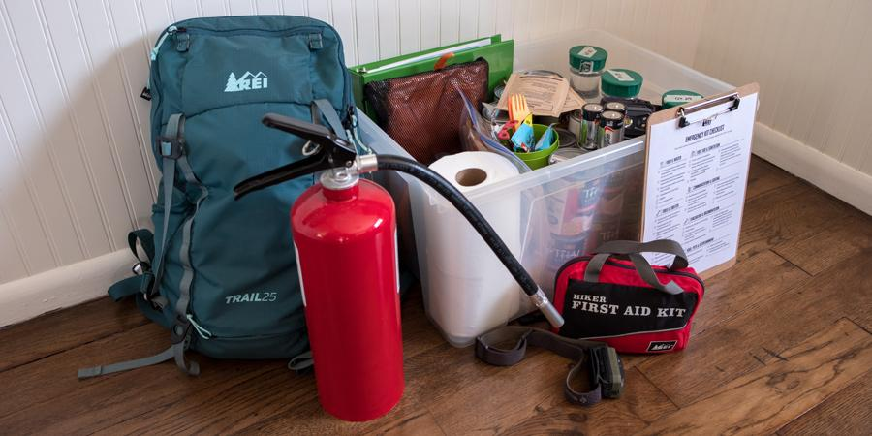
STORE YOUR SUPPLIES
At home
At work
In your car
or carry in-transit

Slide 28
IS YOUR HOME FIRE-SAFE?
SEISMIC SAFETY OUTREACH PROGRAM

Slide 29
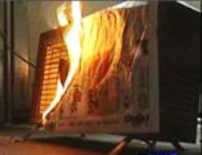
PORTABLE HEATERS
Plug heaters directly into the wall socket, and not into extension cords
Place heaters where they will not be knocked over easily.
Do not use heaters to dry clothing or other items
Turn portable heaters off when you leave the room or go to sleep
Keep heaters at a safe distance from curtains, furniture, and all o combustibles.
SEISMIC SAFETY OUTREACH PROGRAM

Slide 30
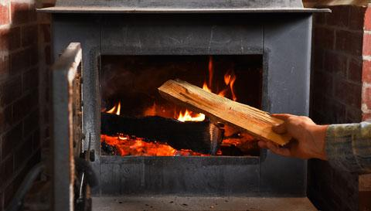
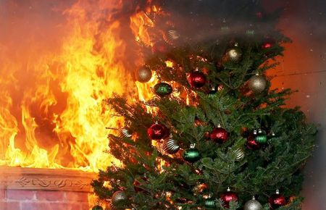
WOODSTOVES & FIREPLACES
Only use seasoned wood, and never use green wood, artificial logs or trash.
Always use a protective screen And Clean interiors, hearths and chimneys yearly.
SEISMIC SAFETY OUTREACH PROGRAM

Slide 31
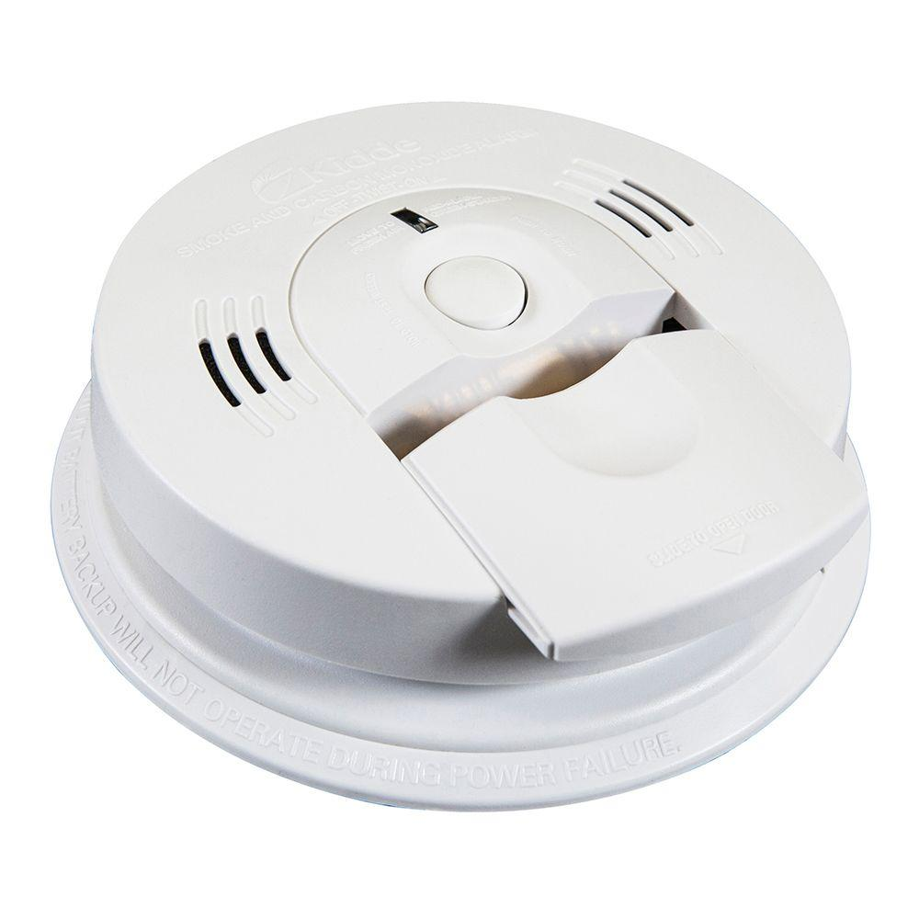
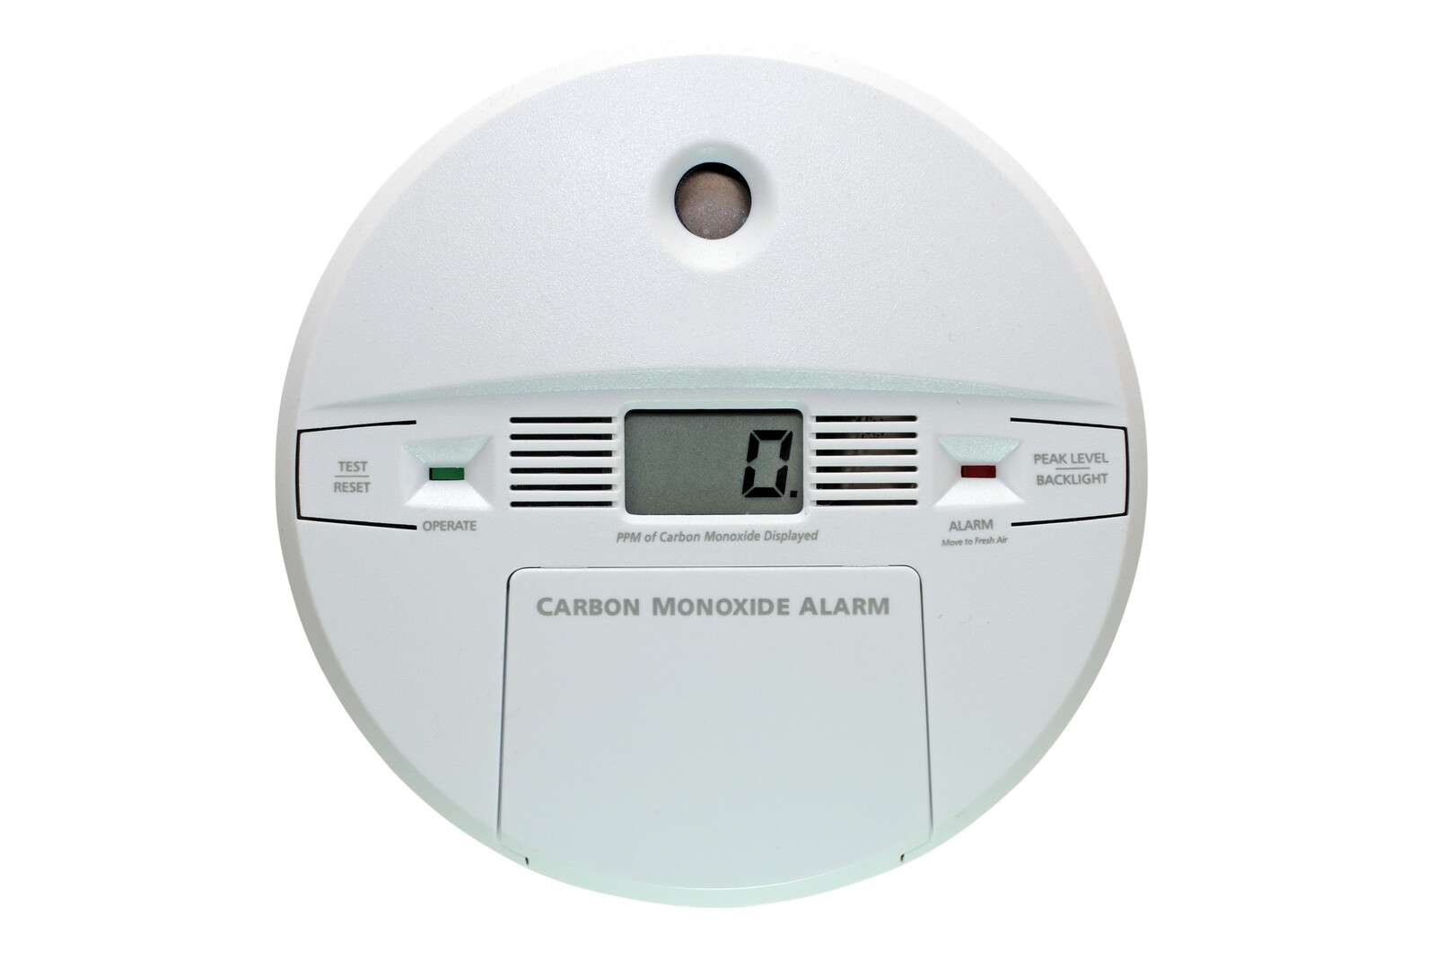
SMOKE DETECTORS
CARBON MONOXIDE
Place smoke detectors inside AND outside of every bedroom
Test the batteries monthly and replace the batteries if needed
Place smoke detectors at least 4 to 6 inches away from walls and corners
Keep away from Bathrooms and Kitchens to prevent False Alarms
Install carbon monoxide alarms in central locations on every level of your home and outside sleeping areas and If the carbon monoxide alarm sounds, move quickly to a fresh air location outdoors or by an open window odoor
SEISMIC SAFETY OUTREACH PROGRAM

Slide 32
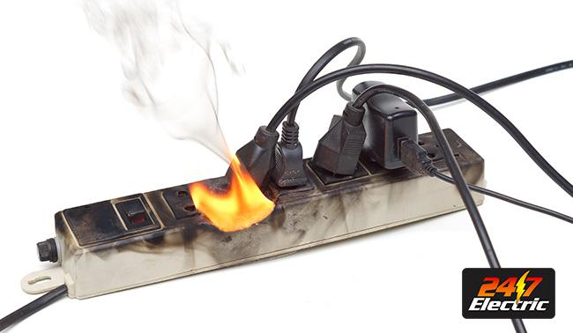
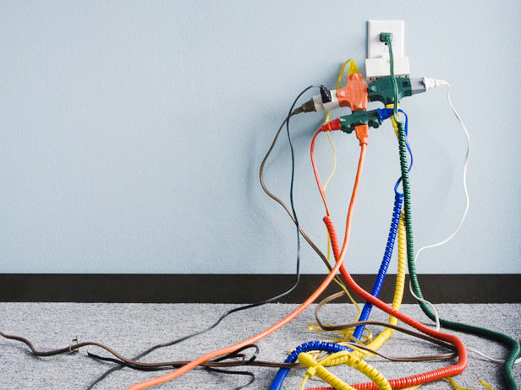
ELECTRICAL WIRING
Replace wiring if it's frayed or cracked
Do not cover the wire , over nails or in high traffic areas
Avoid overloading outlets and make sure they stay cool to the touch
SEISMIC SAFETY OUTREACH PROGRAM

Slide 33
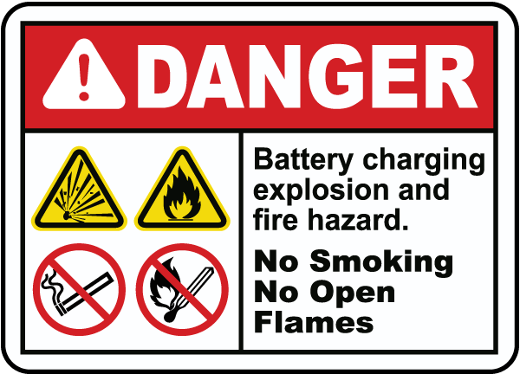
SAFE SMOKING HABITS
SEISMIC SAFETY OUTREACH PROGRAM

Slide 34
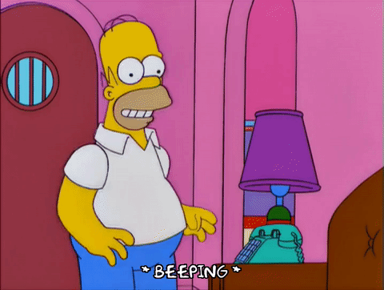
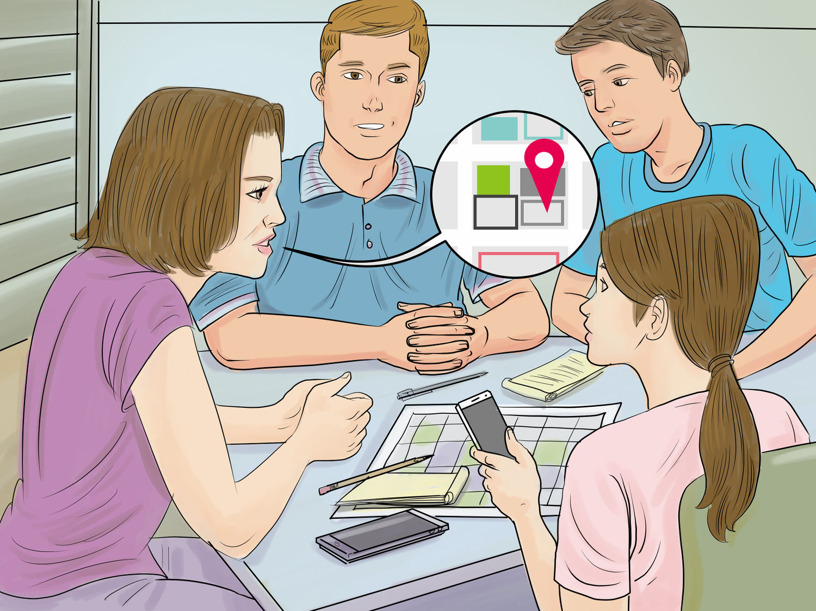
Step 3﹕MAKE A PLAN
Choose an
out-of-area contact
Choose two meeting places
Right outside your home
Outside of your neighborhood

Slide 35
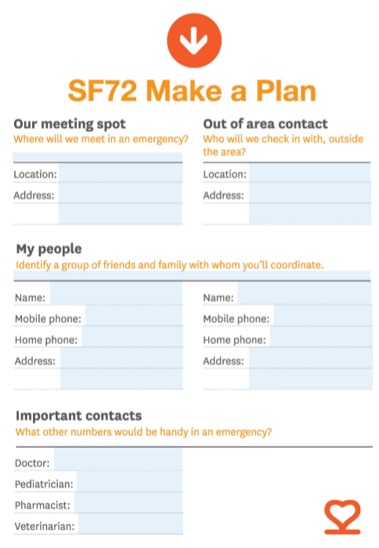
Discuss your family’s emergency communication plan
Identify reunification point
Select out of area contact
Plan Evacuation Route
Gather Supplies
Notes:
Make sure that you store high energy food, such as peanut butter and granola bars, for at least three days. Store extra drinking water. Remember: one person requires at least a gallon of water per day. Plan accordingly.
Because family members can be separated from one another during an emergency, a real possibility during the day when adults are at work and children at school, make sure everyone knows and understands your family’s emergency communication plan.
Choose an out-of-town contact your family or household will call or e-mail to check on each other should a disaster occur. Make sure every household member has that contact’s, and each other’s, e-mail addresses and telephone numbers.
Check on the school emergency plan of any school-age children you may have. Be sure that the school has updated information about how to reach parents and responsible caregivers to arrange for pickup.
Local officials may call for evacuation in specific areas at greatest risk in your community. Have a plan for how you will evacuate and be prepared to listen to local officials who will provide further instruction.

Slide 36
HOME FIRE ESCAPE PLAN
Have an escape plan & make sure all family members know it
Practice the plan every 6 months
Keep emergency number, a whistle & a flashlight near the telephone
Identify an outside meeting place and never return a building

Slide 37
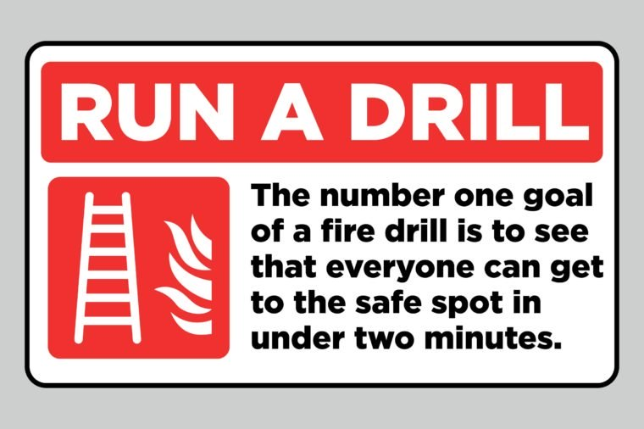
PRACTICE FIRE DRILL

Slide 38
IS YOUR FURNITURE SECURED?
ARE YOU HOME ITEMS SECURE?
SEISMIC SAFETY OUTREACH PROGRAM

Slide 39
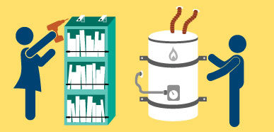
Identify Potential Hazards -
Top-heavy Furniture
Loose Objects e.g. Lamps on shelves
Hanging pictures & mirrors
Glassware, dishes, kitchenware
Flammable Materials
Water Heater
SEISMIC SAFETY OUTREACH PROGRAM

Slide 40
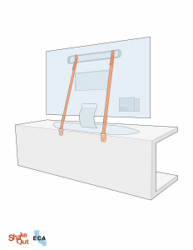
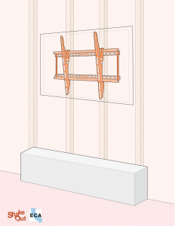
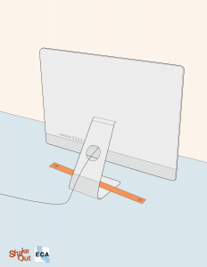
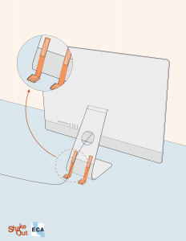
Secure Television & Electronics
They can be secured with flexible nylon straps and buckles for easy removal and relocation. Commercial packages are available at hardware stores
#2 – Another easy way to protect against these types of losses is to use Velcro™ or other similar products.
SEISMIC SAFETY OUTREACH PROGRAM

Slide 41
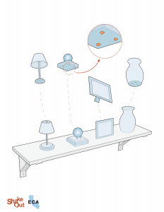
Secure small objects @ home
Move heavy items and breakables to lower shelves.
Use either hook and loop fasteners on the table and object, or non-damaging adhesives such as earthquake putty, clear quake gel, or microcrystalline wax to secure breakables in place.
Museum Wax or Quick Hold
SEISMIC SAFETY OUTREACH PROGRAM

Slide 42
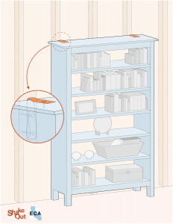
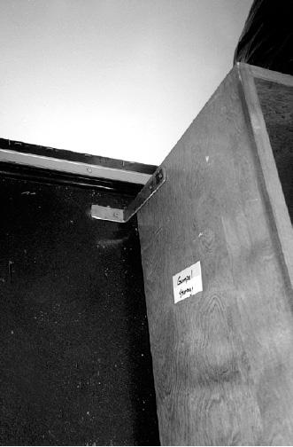
Secure bookcases
Tall furniture should be attached to wall studs to avoid toppling in an earthquake.
Place heavy and/or large items on lower shelves to prevent them from flying around the room in an earthquake.
SEISMIC SAFETY OUTREACH PROGRAM

Slide 43
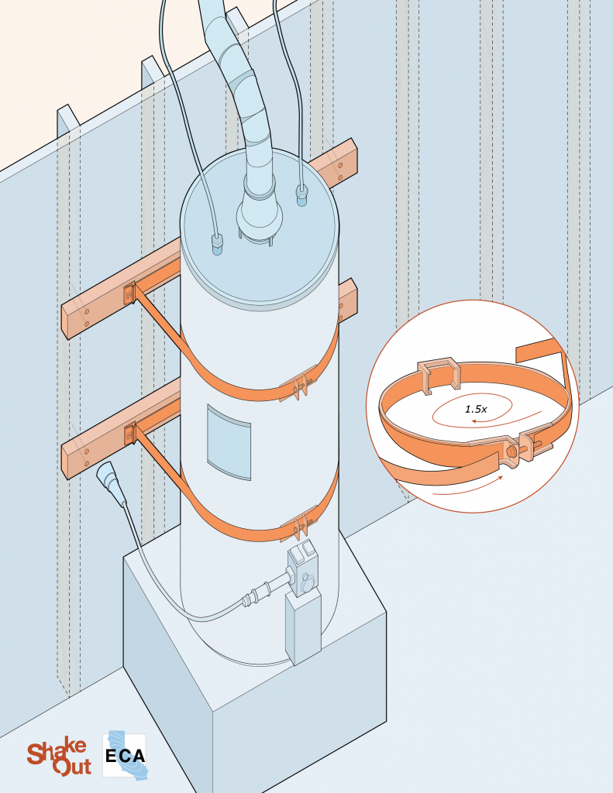
Secure Water Heater
Fresh water after a disaster may be as close as your water heater – provided, of course, that it remains standing upright. A typical water heater holds 30 to 50 gallons of water. However, this supply of water is extremely vulnerable to ground undulation (swells and rolls) and ground acceleration of earthquakes, causing them to tip over.
You can protect this valuable resource by securing your water heater to the wall studs.
SEISMIC SAFETY OUTREACH PROGRAM

Slide 44
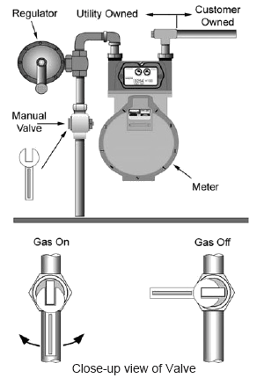
MANUAL GAS SHUT OFF
Use the wrench to turn off the manual valve located at the gas meter
Shut off your gas only if you
Smell gas
Hear gas escaping
Suspect a broken gas pipe, appliance, vent, or flue.
Monoxide detector goes off
Once the gas has been shut off, service can be restored only by utility personnel or qualified plumbers
SEISMIC SAFETY OUTREACH PROGRAM

Slide 45
BEST PRACTICES
Check your disaster plans and replace water and food every six months
Review the details of your disaster plan with all family members
Make sure everyone knows the locations of disaster supply kits and emergency contact information.
Practice Your Plan

Slide 46
Seismic Safety Outreach Program
THANK YOU!

