Slide 2
POST DISASTER: RECOVERY
SEISMIC SAFETY OUTREACH PROGRAM
Some Resource Pictures from Google.com

Slide 3
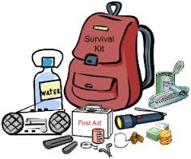
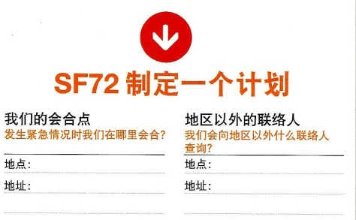
SF DEPARTMENT OF EMERGENCY
The Three Actions for Disaster Preparedness:
Get Connected
Gather Supplies
Make A Plan

Slide 4
DISASTER RICKS & IMPACTS
Whether traditional disasters, like house fires, earthquake, act of terrorism, the Seismic Safety Outreach Program can help you PREPARE, RESPOND & RECOVER

Slide 5
RECONNECT & RECOVER

Slide 6
AFTER the next big earthquake,
your recovery and that of the community may take weeks, months or even longer. While earthquakes can be traumatic experiences, it’s important not to let things slip that will help you, your family, and your community get back on your feet. While this phase only has one step, the time involved will most likely be the longest, especially if your home or workplace has been damaged.

Slide 7
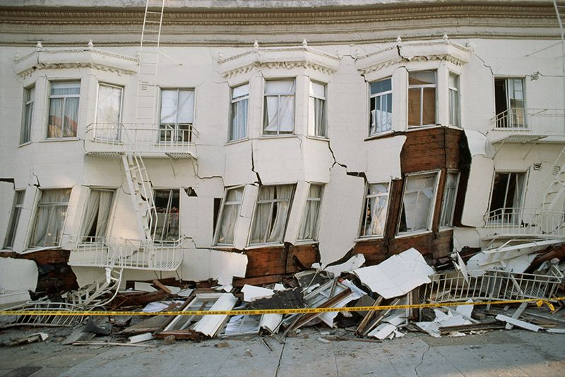
After a Quake
Once you have dealt with urgent and immediate needs after an earthquake, continue to follow the plan you prepared in advance.
Aftershocks will continue to happen for several weeks after major earthquakes. Some may be large enough to cause additional damage.
Always be ready to drop, cover, and hold on.

Slide 8
After a Quake
Leave a Trail
Stay Tuned
Check SF72.org

Slide 9
LET PEOPLE KNOW YOU ARE OK!
USE SOCIAL MEDIA TO LET YOUR LOVED ONES KNOW YOU ARE OKAY
PHONE SERVICE MAY BE OUT.
WHEN POSSIBLE, TEXT OR CALL YOUR OUT-OF AREA CONTACT & TELL THEM WHERE YOU ARE, THEN STAY OFF THE PHONE.
This will allow calls to be made for emergencies.

Slide 10
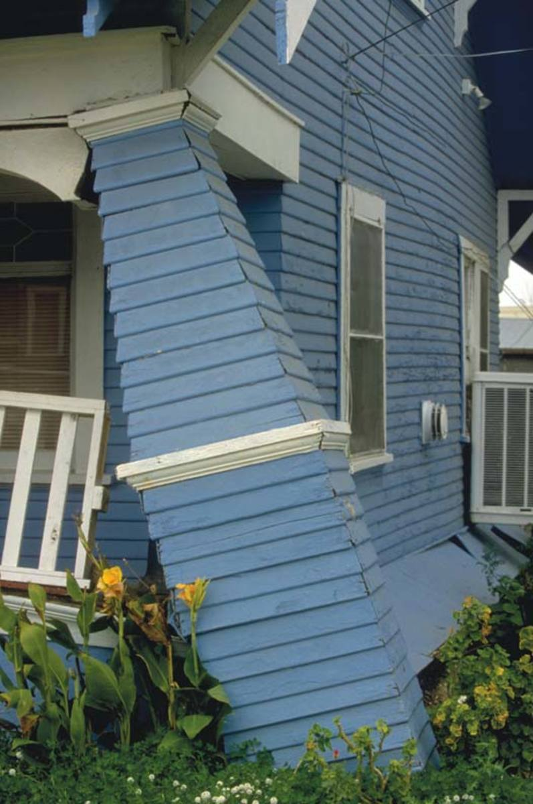
Make A Plan – Post Disaster
Assess the Risk
Inspect exterior, determine physical damage of home and confirm structure of building is safe
Re-check in case of after shock

Slide 11
CONTINUITY PLAN
If your gas was turned off, you will need to arrange for the gas company to turn in back on.
If your water lines brake, look for water damage.
Locate and/or replace critical documents that may have been misplaced, damaged, or destroyed.

Slide 12
STEP 1: Getting started with your recovery
Contact your landlord & insurance companies
Arrange for protection of your possessions and property
Contact your employer to let them know about your situation & that you are working on a recovery plan
Contact Family members so they know where you are and how to contact you
Find temporary housing for your pet

Slide 13
STEP 2: Develop your Recovery Plan
Make a list of what you need for recovery
Make a list of your support systems
Make a list of financial resources
Identify other community resources to help with your recovery
Replace legal documents
Report change of address

Slide 14
If you cannot stay in your home -
If your home is structurally unsafe or threatened by a fire or other hazard, you need to evacuate.
Do not leave home just because utilities are out of service or your home and its contents have suffered moderate damage.
If you do evacuate, tell a neighbor and your out-of-area contact where you are going.
As soon as possible, set up an alternative mailing address with the post office in person or online with the USPS.

Slide 15
WHEN YOU EVACUATE
TAKE THE FOLLOWING –
Personal disaster supplies kit
Medications and eyewear
Supply of water, food, and snacks
Blanket/pillow/air mattress or sleeping bag
Change of clothing and a jacket
Towel and washcloth
Diapers, food, and other supplies for infants
A few family pictures or other comfort items
Personal identification and copies of household and health insurance information

Slide 16
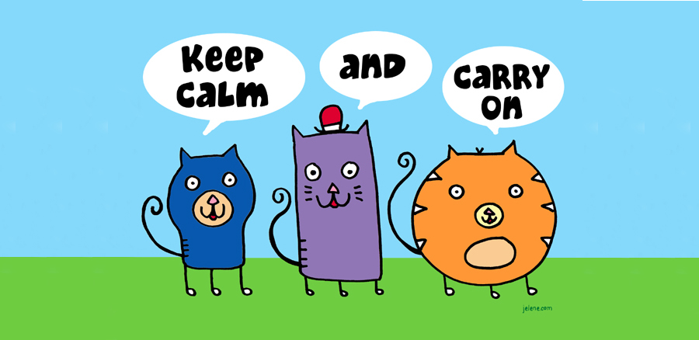
STAY CALM – keep calm & carry on

Slide 17
AFTER AN EARTHQUAKE - RECOVERY
There are a number of community-based agencies that will provide free recovery services after a catastrophic events such as
the Salvation Army,
Tzu Chi Foundation,
American Red Cross
Faith-based organizations.

Slide 18
Taking care of your Emotional Health
There is a natural grieving process following any loss, and a disaster of any size will cause unusual and unwanted stress as you attempt to reconstruct your life

Slide 19
Taking care of your Emotional Health
The emotional effects of a disaster may show up immediately or may appear many months later.
Pay Attention to:
Symptoms of Chronic Stress
Take ACTION

Slide 20
DO NOT TAKE TO A SHELTER:
YOUR PETS
LARGE QUANTITIES OF UNNECESSARY CLOTHING
VALUABLES THAT MIGHT BE LOST, STOLEN, OR TAKEN

Slide 21
ONCE YOU HAVE RECOVERED FROM A DISASTER
LEARN FROM WHAT HAPPENED DURING THE DISASTER & RECOVER QUICKLY NEXT TIME.

Slide 22
Once a Presidential Declaration has been issued, FEMA may activate the Individuals and Households Program www.fema.gov/about/process. This program includes:
Home-repair cash grants; the maximum Federal grant available (as of 2005) is $26,200
Housing Assistance in the form of reimbursement for short-term lodging at a hotel
Rental assistance for as long as 18 months in the form of cash payment
If no other housing available, FEMA may provide mobile homes or other temporary housing
Sources: earthquakecountry.org

Slide 23
Seismic Safety Outreach Program
THANK YOU!

