Slide 2
DURING DISASTER: RESPONSE
SEISMIC SAFETY OUTREACH PROGRAM
Some Resource Pictures from Google.com

Slide 3
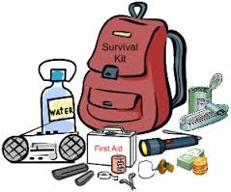
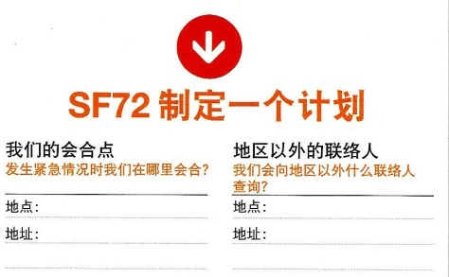
SF DEPARTMENT OF EMERGENCY
The There Actions for Disaster Preparedness:
Get Connected
Gather Supplies
Make A Plan

Slide 4
Basic Safety Tips: When Disaster Strikes
Because we live in an area where earthquake are expected, and we cannot predict when an earthquake hits, it is important to conduct response drills regularly.

Slide 5
EARTHQUAKE SAFETY
1. Drop, Cover, and hold on
During earthquake & aftershocks

Slide 6
In case of EARTHQUAKE
Nothing Sturdy to get under?
Unable to Get to floor?
Sit against an interior wall.
COVER HEAD & NECK!
REMAIN SEATED
COVER HEAD AND NECK

Slide 7
In case of EARTHQUAKE
If you are in a wheelchair
Lock the brake & cover your head
If you are in bed
Remain in bed
Pull covers up
Use pillow to cover head
Be aware of breaking glasses

Slide 8
In case of EARTHQUAKE
If you are OUTSIDE
Get inside if you close to a building
If not, get to an open area

Slide 9
In case of EARTHQUAKE
Do not get up against buildings because most people are injured by falling debris off building
Protect yourself during aftershocks

Slide 10
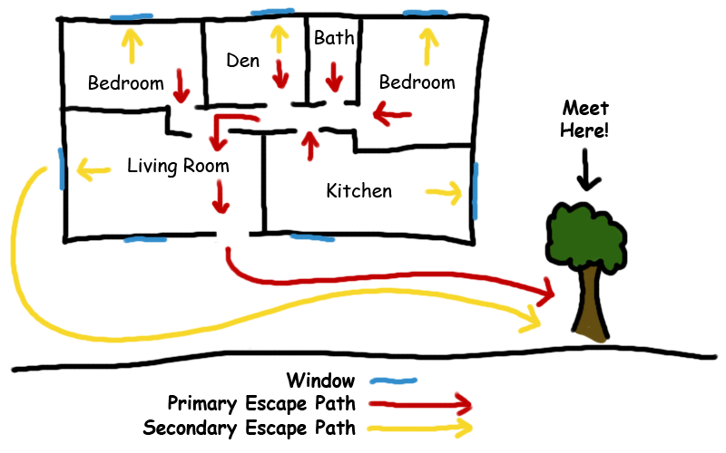
In case of FIRE
TWO WAYS TO ESCAPE & DESIGNATED MEETING PLACE

Slide 11
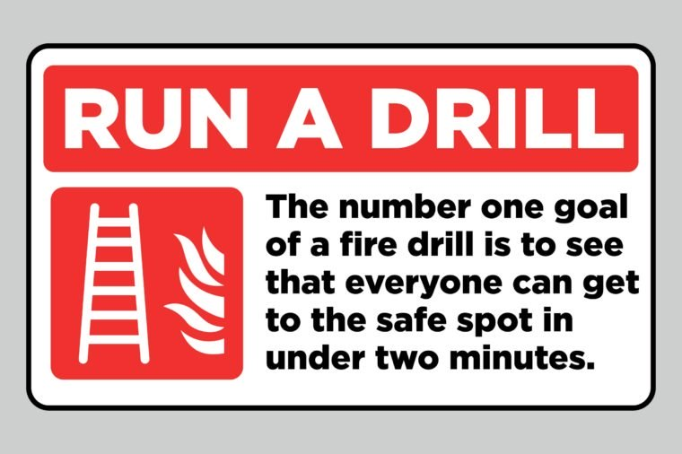
PRACTICE FIRE DRILL

Slide 12
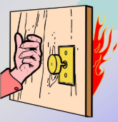
In case of FIRE
GET OUT & STAY OUT & CALL 911
CHECK WARMTH OF DOOR BEFORE OPENING
USE BACK OF YOUR HAND TO FEEL THE DOOR KNOB
IF ITS WARM – DO NOT OPEN

Slide 13
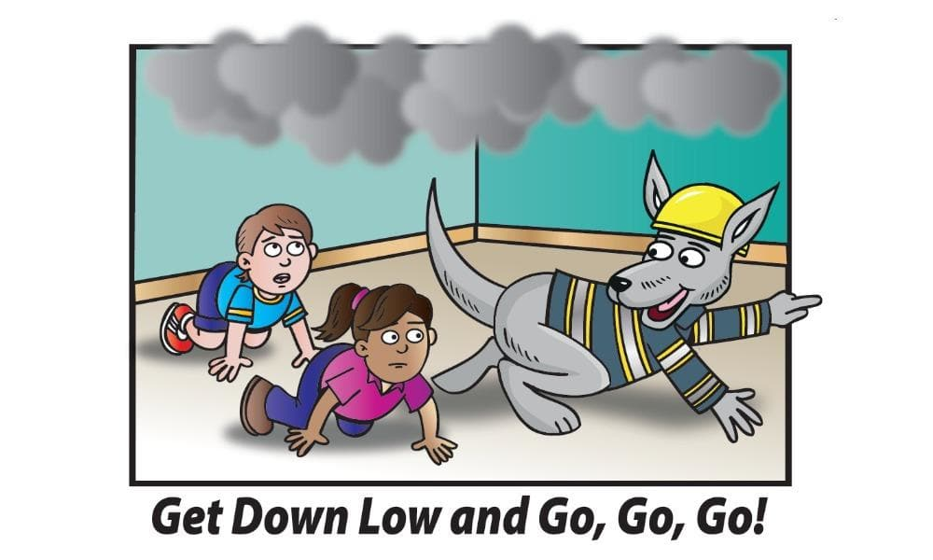
In case of FIRE
If you must EXIT through smoke, CRAWL LOW under the smoke.

Slide 14
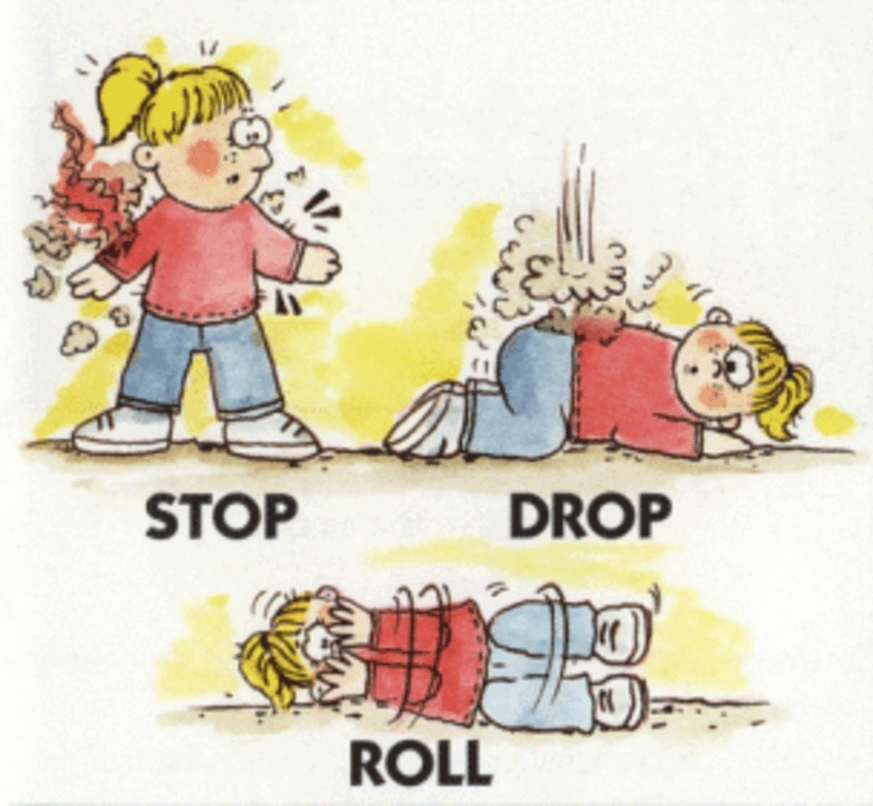
In case YOUR CLOTHES CATCH ON FIRE
STOP, DROP & ROLL

Slide 15
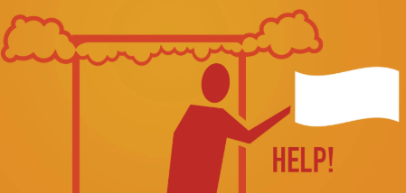
In case of FIRE EXIT BLOCKED
Stay indoor with DOOR CLOSED
Place WET TOWEL under the door
CALL 911
Open window & Wave a brightly colored cloth or flashlight for help.

Slide 16
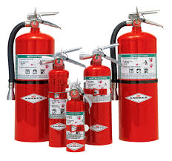
FIRE EXTINGUISHERS

Slide 17
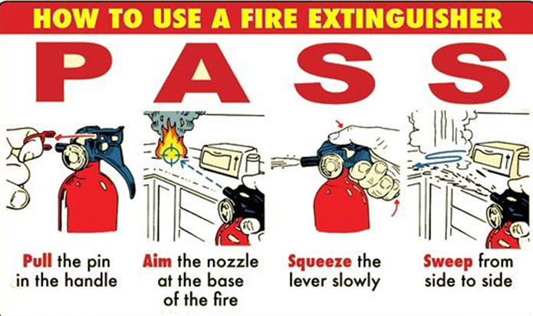
FIRE EXTINGUISHERS
6 TO 8 FEET AWAY FROM FIRE

Slide 18
Seismic Safety Outreach Program SHELTER IN PLACE

Slide 19
SHELTER IN PLACE
Whether you are at home, work or elsewhere, there may be situations when it is simply best to stay where you are and avoid any uncertainty outside.

Slide 20
Situations that require Sheltering in Place?

Slide 21
Post Disaster Civil unrest Active Threat Biological/Radiological incident Accidental chemical exposure Pandemic flu Any Others?

Slide 22
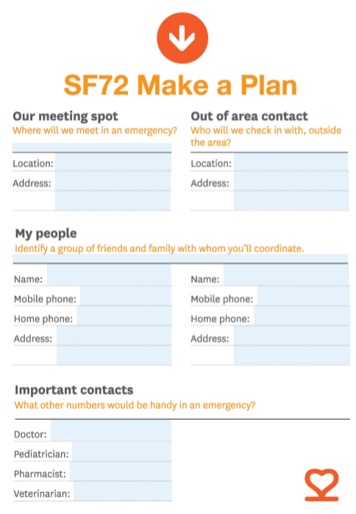
Discuss your family’s emergency communication plan
Identify reunification point
Select out of area contact
Plan Evacuation Route
Gather Supplies
Notes:
Make sure that you store high energy food, such as peanut butter and granola bars, for at least three days. Store extra drinking water. Remember: one person requires at least a gallon of water per day. Plan accordingly.
Because family members can be separated from one another during an emergency, a real possibility during the day when adults are at work and children at school, make sure everyone knows and understands your family’s emergency communication plan.
Choose an out-of-town contact your family or household will call or e-mail to check on each other should a disaster occur. Make sure every household member has that contact’s, and each other’s, e-mail addresses and telephone numbers.
Check on the school emergency plan of any school-age children you may have. Be sure that the school has updated information about how to reach parents and responsible caregivers to arrange for pickup.
Local officials may call for evacuation in specific areas at greatest risk in your community. Have a plan for how you will evacuate and be prepared to listen to local officials who will provide further instruction.

Slide 23
You get ONE FLUSH!
The water stored in your toilet tank will provide only ONE flush before you need to find alternatives for sanitation.
*One gallon water per person per day does not include water for refilling the toilet.
Keep a supply of heavy duty trash bags

Slide 24
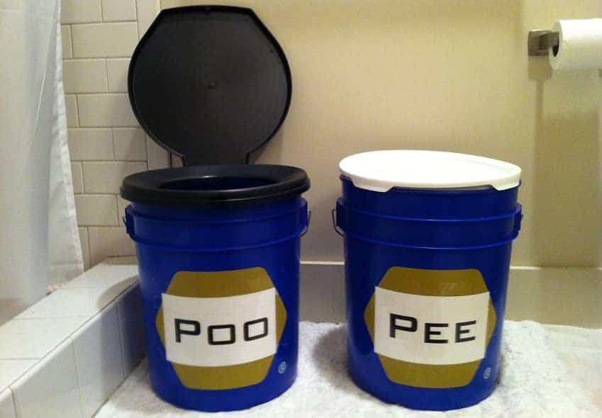
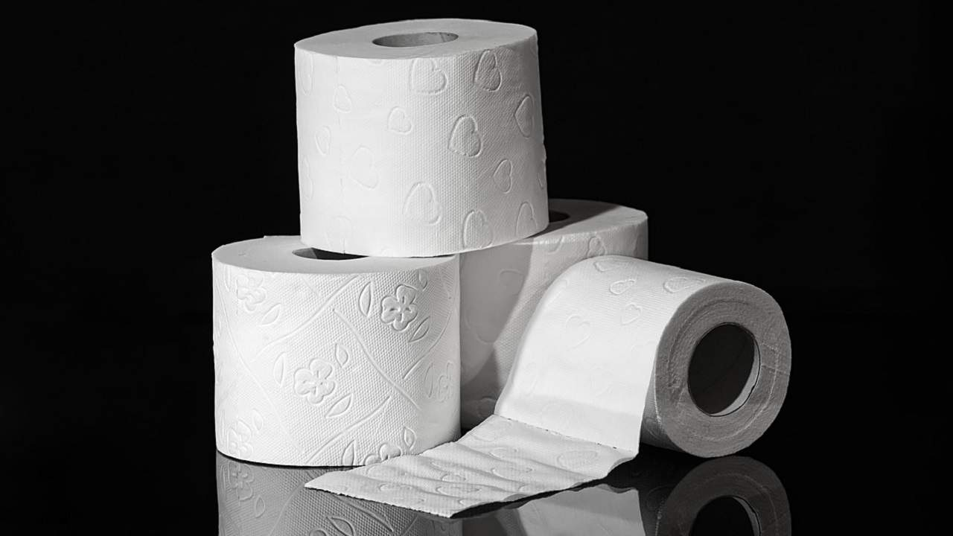
Large container for sanitary items:
Toilet Paper

Slide 25
RESOURCES
NEIGHBORHOOD SHELTERS
Make A Plan with neighbors at block level (NEXTDOOR)
Gather general camping supplies
Tents, tarps, sleeping bags, portable stoves, camping vehicle
Public Shelters
Pay attention to information sources to see what shelter/food distribution will be available.
Your GO-BAG provides temporary support needed to move from home to shelter
Will provide general assistance

Slide 26
INFORMATION SOURCES
SFDEM: SF72.org
Red Cross: redcross.org
SF NERT: sfgov.org/sffdnert
FEMA: fema.gov
ALERT SF - Sign up via text 888-777
Official Radio Stations
TV stations
NEXTDOOR

Slide 27
For severe weather & civil unrest that pose a physical threat:
Stay inside & move away from windows to the inner corridors
Be sure to close all doors connecting exterior offices to the corridor
For extreme weather, relocate to lower levels in the building

Slide 28
QUESTIONS?
SEISMIC SAFETY OUTREACH PROGRAM

Slide 29
Seismic Safety Outreach Program
THANK YOU!

